Slide 1
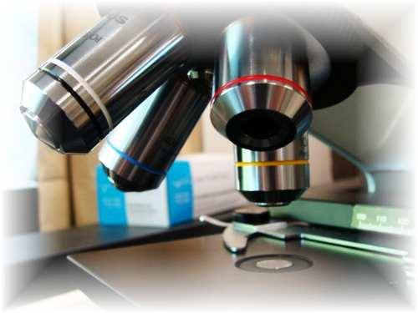
About Science Prof Online
PowerPoint Resources
Science Prof Online (SPO) is a free science education website that provides fully-developed Virtual Science Classrooms, science-related PowerPoints, articles and images. The site is designed to be a helpful resource for students, educators, and anyone interested in learning about science.
The SPO Virtual Classrooms offer many educational resources, including practice test questions, review questions, lecture PowerPoints, video tutorials, sample assignments and course syllabi. New materials are continually being developed, so check back frequently, or follow us on Facebook (Science Prof Online) or Twitter (ScienceProfSPO) for updates.
Many SPO PowerPoints are available in a variety of formats, such as fully editable PowerPoint files, as well as uneditable versions in smaller file sizes, such as PowerPoint Shows and Portable Document Format (.pdf), for ease of printing.
Images used on this resource, and on the SPO website are, wherever possible, credited and linked to their source. Any words underlined and appearing in blue are links that can be clicked on for more information. PowerPoints must be viewed in slide show mode to use the hyperlinks directly.
Several helpful links to fun and interactive learning tools are included throughout the PPT and on the Smart Links slide, near the end of each presentation. You must be in slide show mode to utilize hyperlinks and animations.
This digital resource is licensed under Creative Commons Attribution-ShareAlike 3.0:
http://creativecommons.org/licenses/by-sa/3.0/
Alicia Cepaitis, MS
Chief Creative Nerd
Science Prof Online
Online Education Resources, LLC
alicia@scienceprofonline.com
Tami Port, MS
Creator of Science Prof Online
Chief Executive Nerd
Science Prof Online
Online Education Resources, LLC
info@scienceprofonline.com
From the Virtual Biology Classroom on ScienceProfOnline.com
Image: Compound microscope objectives, T. Port
Notes:
Welcome to Science Prof Online PowerPoint Resources!
This PowerPoint Presentation comes from the Virtual Cell Biology Classroom of Science Prof Online, and, as such, is licensed under Creative Commons Attribution-ShareAlike 3.0.; meaning you can download, share and alter any of this presentation, but you can’t sell it or repackage and sell any part of it. Please credit Science Prof Online as the source of this presentation. Please abide by credited image copyrights. Thank you for using this resource.

Slide 2
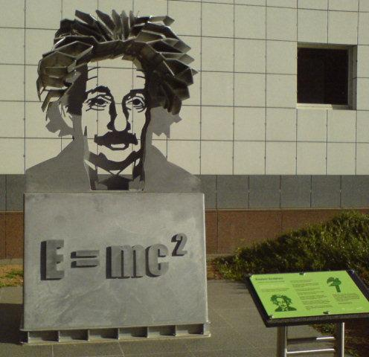
Matter
&
Energy
From the Virtual Biology Classroom on ScienceProfOnline.com
Image: Sculpture of Albert Einstein & E=MC2, Wiki
Notes:
2

Slide 3
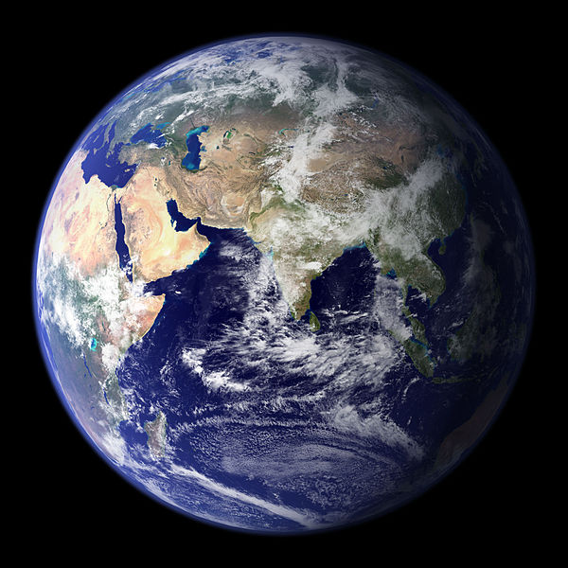
Chemistry
The basis of all substances in our world
From the Virtual Biology Classroom on ScienceProfOnline.com
Image: Earth, Wiki
Notes:
3

Slide 4
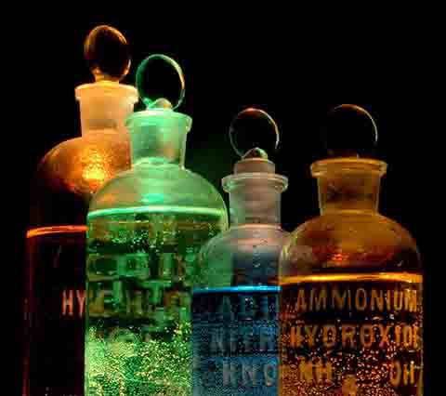

Chemistry
The Study of Matter
  Structure → what it’s made of
  Properties → how it behaves
  Changes → how and why it
  changes
Matter → anything that:
  Has mass
  Takes up space
  Most basic components are ATOMS
Substance
  A particular type of matter, such as water or sugar
Image: Chemicals in Flasks, J. Sullivan, Wiki ; Carbon, Universe Today Website
From the Virtual Biology Classroom on ScienceProfOnline.com

Slide 5
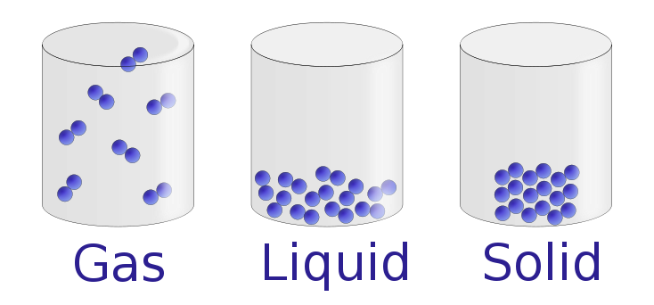
States of Matter
 | Gas | Liquid | Solid
Shape | Whatever | Whatever | Definite
Volume | Whatever | Definite | Definite
Compressible? | Yes | No | No
Molecules far apart and disordered, with little interaction
Intermediate situation
Molecules close together and ordered, with strong interaction
Image: States of matter, Wiki
From the Virtual Biology Classroom on ScienceProfOnline.com

Slide 6
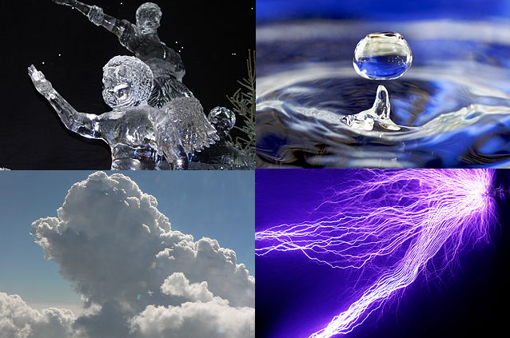
Properties of Matter
Physical properties describe a substance.
  Observed with our senses
    Color, smell, texture
  State of matter at specific temperatures
    Solid, liquid or gas at room temp?
  Examples
    Density, boiling & freezing points, ability to mix or separate solutes and solvents.
    These properties can be used to help ID a substance.
Image: Periodic Table of Elements, NASA
From the Virtual Biology Classroom on ScienceProfOnline.com

Slide 7
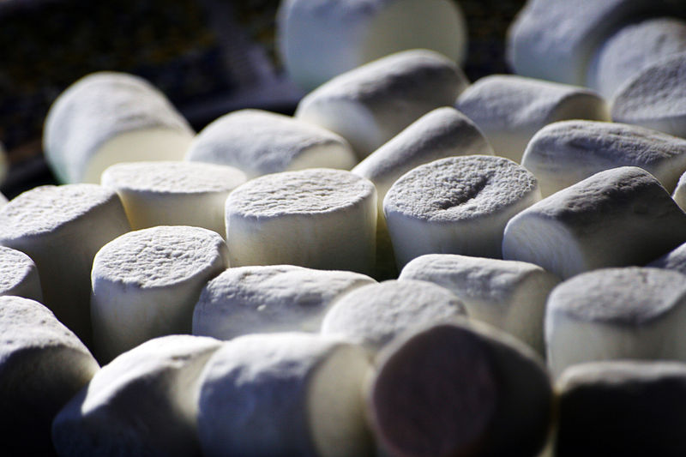
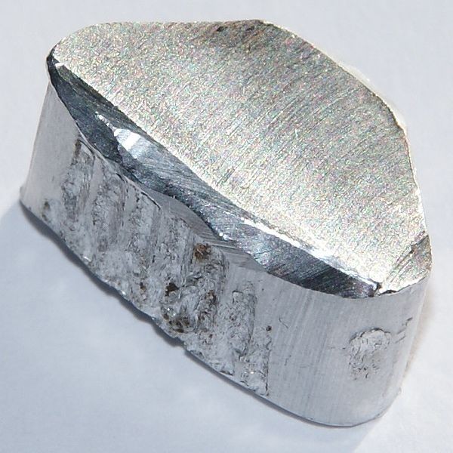
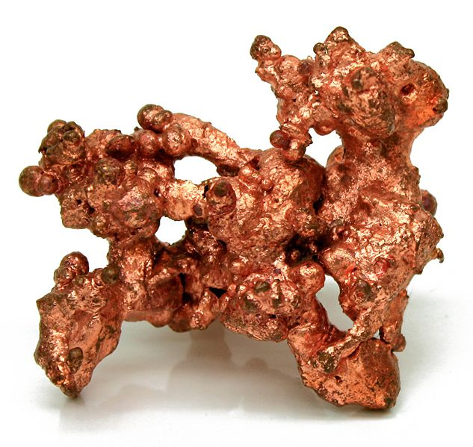
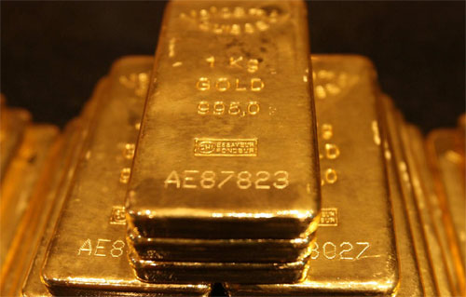
Density
The density of a marshmallow is about 0.4 g/ml
Density is a physical property.
Different materials can have different densities.
Density = weight/volume
Densities of Various Metals
Aluminum = 2.70 g/mL
Zinc = 7.13 g/mL
Iron = 7.87 g/mL
Copper = 8.96 g/mL
Silver = 10.49 g/mL
Lead = 11.36g/mL
Gold = 19.32 g/mL
These values/properties can be used to help decide what kind of metal you have.
Image: Marshmallows, Aluminum, Copper, Gold bars, Wiki
From the Virtual Biology Classroom on ScienceProfOnline.com

Slide 8
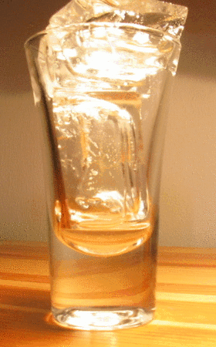

Physical Changes in Matter
  Matter can change in physical appearance, but it is still the same substance.
  Example: Water freezes or boils, but it is still water.
  How do I know if a change is physical? The substance can easily go back to previous form.
  Other types of physical changes:
  Mixtures, such as sugar water solution
  Candle melting
  Breaking glass
Images: Michigan snow storm, T. Port; Melting ice, Wiki
From the Virtual Biology Classroom on ScienceProfOnline.com

Slide 9
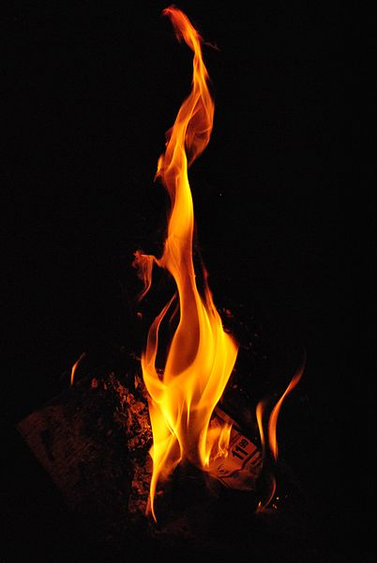
Chemical Changes in Matter
  The change of one substance into another that has a different chemical identity = chemical reaction
  How do I know if a change is chemical?
  It’s difficult to get original substances back!
Example: Burning Wood
  change in the structure of matter (wood becomes ash and smoke)
  one substance is “used up” (wood is gone)
  others substance(s) “appear”(ash and smoke)
Image: Fire, Wiki
From the Virtual Biology Classroom on ScienceProfOnline.com

Slide 10
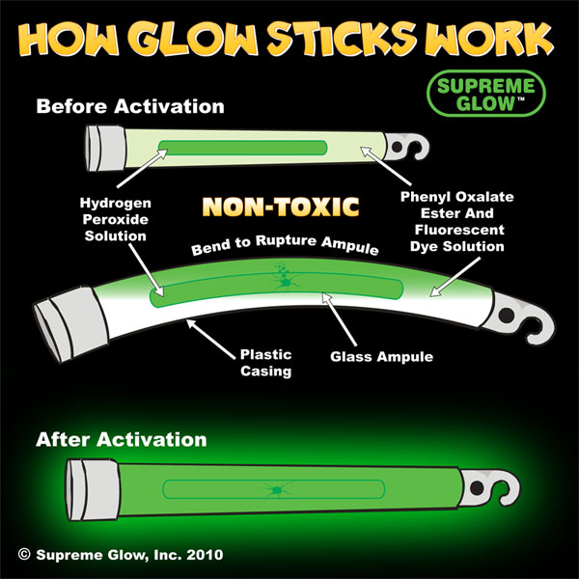
Another Example of a Chemical Change
Change in color
Production of a gas (bubbles or smoke)
Change in temperature, production of heat
Permanent change in the state of matter
Can’t easily get original substances back
From the Virtual Biology Classroom on ScienceProfOnline.com

Slide 11


Comparison of a
Physical & Chemical Change
Mixture = Physical combination of two or more pure substances.
Compound = Chemical combination of two or more pure substances in a fixed, definite proportion.
Components of a mixture usually can be separated by physical means such as distillation, evaporation, etc.
Physical Mixture - Iron & Sulfur
Iron filings may be mixed with powdered sulfur in any proportion.
The two components are easily separated by means of a magnet.
The magnet will draw out the iron from the mixture.
Chemical Compound – Iron sulfide (Pyrite or Fools Gold)
a. seven parts iron filings or powder are mixed with four parts powdered sulfur
mixture is heated to a red glow
iron and sulfur form a compound - iron sulfide (fool’s gold); chemically combined, not readily separated.
Click here to watch some amazing chemical reactions!
Watch This!
Mixture vs Compound
From the Virtual Biology Classroom on ScienceProfOnline.com
Notes:
Mixture
Compound

Slide 12
Important Measurements We Will Be Using in Lab
Measurement | Metric Base Unit | English Unit
Mass (weight) | gram (g) | Oz., Pound, Ton
Volume | liter (L) | Tsp., Pint, Gallon
Length | meter (m) | Inch, foot, yard
Temperature | degree Celcius (°C) | Fahrenheit (°F)
Density = mass/volume | g/mL = g/cc | lb/gallon
From the Virtual Biology Classroom on ScienceProfOnline.com

Slide 13
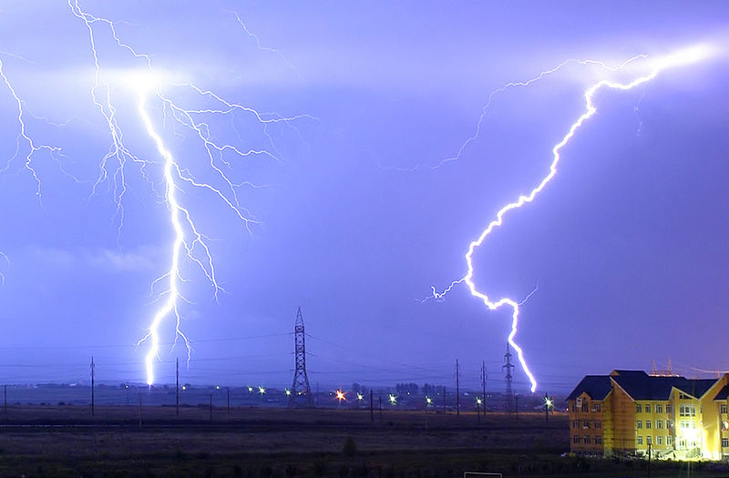
Chemistry also studies
Energy
Capacity to do work
(ex: move a car, move a
muscle)
Commonly measured as calories .
Symbols:
E = Energy
KE = Kinetic Energy
PE = Potential Energy
In a typical lightning strike, electric potential energy is converted into the same amount of energy in other forms, most notably light energy, sound energy and thermal energy.
From the Virtual Biology Classroom on ScienceProfOnline.com
Image: Lightning, Wiki

Slide 14
Kinetic vs. Potential Energy
Kinetic energy KE | Potential energy PE
Energy of motion Examples: Auto collision Molecular motion of air blowing out candles Arrow flying from drawn bow | “Stored” energy Examples: Momentum of car before impact Energy contained in chemical bonds of food we eat Energy in the drawn bow
From the Virtual Biology Classroom on ScienceProfOnline.com

Slide 15
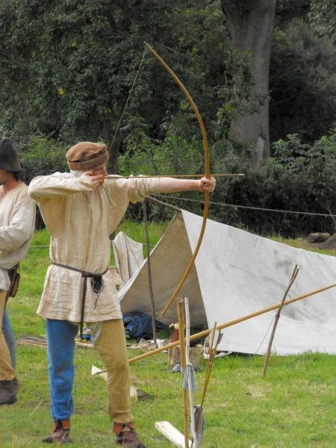
Everyday Science
Law of Conservation of Energy
All energy in the universe is constant (cannot be created or destroyed).
But energy can be converted between forms.
Amount of E is constant.
Form of E is not.
Example: When archer draws the string back, chemical energy of the archer's body is transformed into elastic potential energy in the bent bow. When the string is released, potential energy in the bow is transformed into kinetic energy of the arrow as it takes flight.
Image: Archer, Wiki
From the Virtual Biology Classroom on ScienceProfOnline.com

Slide 16

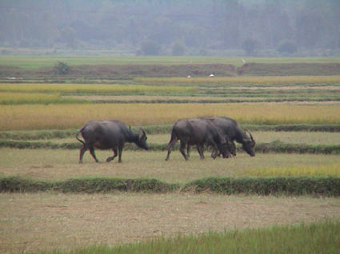
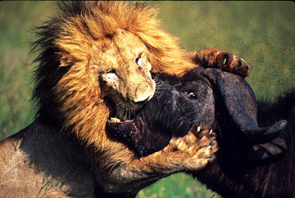
Energy Exchange in an Ecosystem
Solar energy powers most life on earth.
Plants convert sunlight energy into PE stored as calories in the chemical bonds of sugars (food).
Animals eat plants, or other animals, and transform the PE of food calories into the energy of body heat, movement, and the cellular work needed to stay alive.
♪ It’s the circle...the circle of LIFE ♪
The cycling of matter as nutrients.
The flow of energy thru the food chain.
Amount of energy is constant, form is not.
From the Virtual Biology Classroom on ScienceProfOnline.com

Slide 17
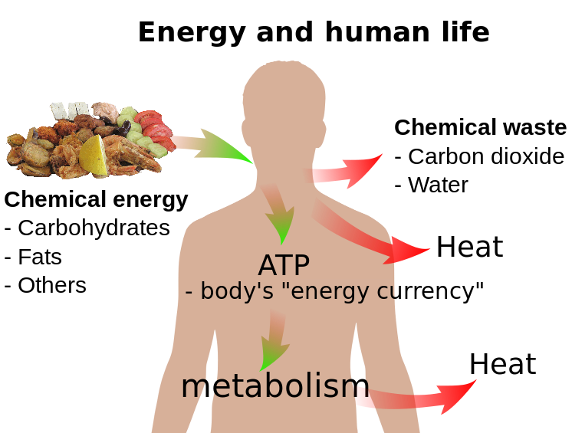
From the Virtual Biology Classroom on ScienceProfOnline.com
Image: Energy and human life, Wiki
Notes:
17

Slide 18
Confused?
Here are some links to fun resources that further explain Chemistry:
Matter Is the Stuff Around You from Chem4Kids.
Inorganic Chemistry Main Page on the Virtual Cell Biology Classroom of Science Prof Online.
“Chemistry” a song by Kimya Dawson.
Chem4Kids website by Rader.
“Better Living Through Chemistry” a song by Queens of the Stone Age.
“Chemistry” a song by Rush.
(You must be in PPT slideshow view to click on links.)
Smart Links
From the Virtual Biology Classroom on ScienceProfOnline.com

